Slide 1


SAPTHAGIRI COLLEGE OF ENGINEERING
(Affiliated to Visvesvaraya Technological University, Belagavi & Approved by AICTE, New Dehli)
Recognized by AICTE, New Delhi & Affiliated to VTU, Belagavi) An ISO 9001:2015 & 14001:2015certifiedinstitutionAccredited by NAAC with ‘A’ grade Accredited by NBA 14/5, Chikkasandra, Hesaraghatta Main Road, Bengaluru – 560 057. Department of Information Science & Engineering
Technical Seminar(18CSS84)
On
“HYPERLOOP TECHNOLOGY”
Presented by:
S Kaushal 1SG19IS087
Under the guidance of:
Prof. Swetha K B
Assistant Professor,
Dept. of I.S.E., S.C.E.
2022-23

Slide 2
CONTENTS
ABSTRACT
INTRODUCTION
TECHNICAL BACKGROUND
SYSTEM ARCHITECTURE
SYSTEM WORKING
RECENT IMPLEMENTATION
MERITS
DEMERITS
APPLICATION
CONCLUSION
FUTURE ENHANCEMENTS
REFERENCES

Slide 3
ABSTRACT
Hyperloop technology is a futuristic mode of transportation that proposed to move people and cargo at high speeds through vacuum-sealed tubes.
It is considered the 5th generation of transportation, following on from the current modes of transportation, such as trains, automobiles, airplanes, and ships.
This presentation will provide an overview of hyperloop technology, including its technical background, merits and demerits, applications, and future enhancements.

Slide 4
INTRODUCTION
Hyperloop is a transportation system that utilizes high-speed pods or capsules that travel through low-pressure tubes, reaching speeds of up to 700 mph (1,125 km/h).
The Hyperloop system proposed to significantly reduce travel times between cities, making it a potential game-changer for long-distance travel.
This technology was first proposed by SpaceX and Tesla CEO Elon Musk in 2013 as a solution to the problems faced by traditional modes of transportation such as high costs, long travel times, and environmental concerns.
Several companies are working on developing and implementing Hyperloop technology, including Virgin Hyperloop, Hyperloop Transportation Technologies (HTT), and SpaceX.

Slide 5
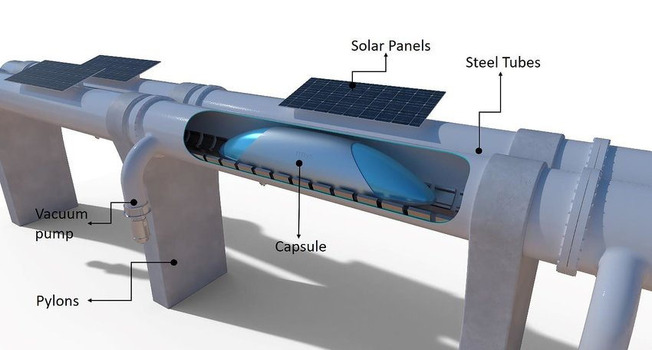
TECHNICAL BACKGROUND SYSTEM ARCHITECTURE
The architecture design of the hyperloop transportation system includes the following components:-
Tubes
Pods
Vacuum Pumps
Energy Source
Control System
(fig1-Hyperloop architecture overview)

Slide 6
Tube: The hyperloop tube is a long, sealed, low-pressure tube that is elevated on columns or constructed underground. The tube is designed to minimize air resistance and enable the pod to travel at high speeds.
Pods: The hyperloop pods are passenger or cargo capsules that travel inside the tube. The pods are autonomous and can operate individually or be coupled together to form a train-like configuration.
Energy source: The hyperloop system requires a significant amount of energy to operate. The energy source can be renewable, such as solar or wind, or traditional, such as natural gas or electricity
Vacuum pumps: The tube is maintained at a low-pressure environment to minimize air resistance, which requires powerful vacuum pumps to maintain the desired pressure inside the tube.

Slide 7
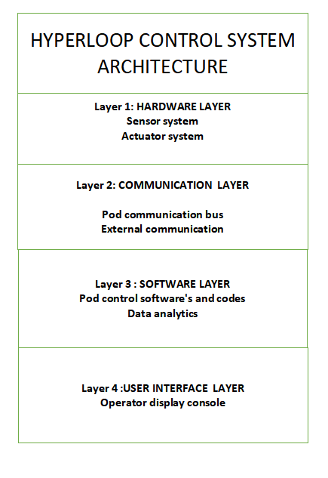
SYSTEM WORKING
Control System:
The control system of a Hyperloop is a crucial part of the overall technology, as it is responsible for ensuring the safe and efficient operation of the system.
The control system of a Hyperloop is be responsible for controlling various components of the system, such as the propulsion system is responsible for accelerating the pod, while the levitation system keeps it hovering above the track. The braking system is used to slow down and stop the pod when necessary.
The control system is also responsible for coordinating the operation of these different components, as well as monitoring their performance and making adjustments as needed.
The control system consist of four layers, including:
Hardware Layer:
Communication Layer:
Software Layer:
User Interface Layer
(fig5- hyperlop control system tier architecture)

Slide 8
Hardware Layer:
This layer would consist of various physical components such as sensors, actuators, motor controllers, power supplies, and other hardware devices that are used to control and monitor the Hyperloop system.
Sensors: These are devices that detect and measure physical parameters such as speed, temperature, pressure, and position. Sensors provide critical feedback to the control system, allowing it to monitor the performance of the system and make adjustments as needed.
example:
Speed sensors: measure the speed of the pod
Temperature sensors: monitor the temperature of various components
Infrared sensors: detect the presence of obstacles on the track
Actuators: These are devices that convert electrical signals into mechanical motion. They are used to control various components of the Hyperloop system, such as the propulsion system, the levitation system, and the braking system.
example:
Linear motors: used for propulsion and braking of the pod
Electromagnets: used for levitation of the pod
Cooling fans: help dissipate heat from various components
Motor controllers: These are electronic devices that control the speed, direction, and torque of electric motors. They are an essential component of the propulsion system in a Hyperloop, as they are used to control the linear motors that accelerate the pod.
Overall, the hardware layer of the control system in a Hyperloop is responsible for providing the physical components that allow the system to operate, and ensuring that they are integrated and coordinated effectively to achieve the desired behavior of the system.

Slide 9
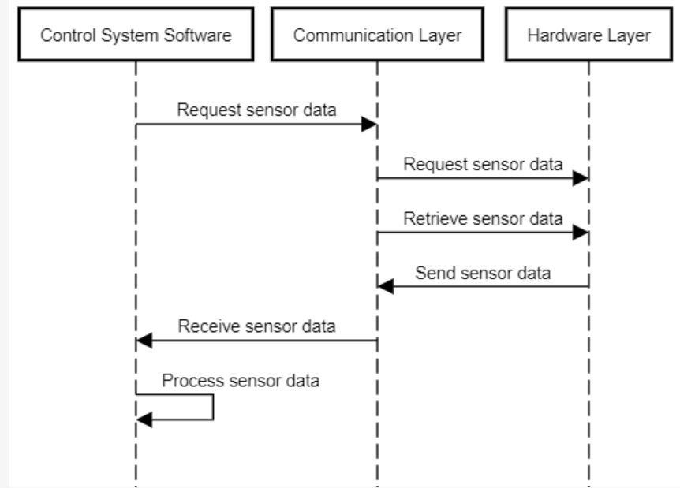
Communication Layer:
In the communication layer, each component of the Hyperloop control system is connected to a communication bus or network that facilitates the exchange of data between the components.
The communication bus can be wired(Ethernet) or wireless (Wi-Fi), and can be implemented using different protocols and standards depending on the specific requirements of the Hyperloop system.
When a component needs to communicate with another component in the system, it sends a message over the communication bus. The message contains the data that needs to be transmitted, as well as information about the sender and receiver components. The recipient component receives the message and processes the data according to the instructions contained in the message.
For example, the control system can use the communication layer to retrieve sensor data from the hardware layer or to send commands to the levitation or propulsion systems
(fig6-communication layer sequence diagram)

Slide 10
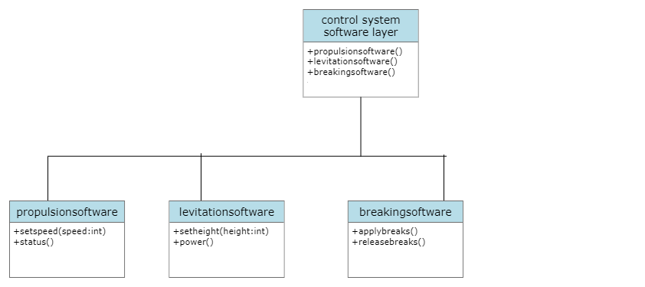
Software Layer:
The software layer would consist of various software programs and logic that are used to control the Hyperloop system. This layer would include the control software for the propulsion system, levitation system, and braking system, as well as any other software required to operate the Hyperloop.
For example, the software layer includes the control software for the propulsion system, which is responsible for accelerating and decelerating the Hyperloop pod. This software uses data from the sensors in the hardware layer and the commands from the control system to adjust the speed of the pod.
Similarly, the software layer also includes the control software for the levitation system, which is responsible for maintaining the levitation height of the pod above the track. This software uses data from the sensors in the hardware layer to adjust the magnetic field strength and keep the pod at the correct height.
Safety and fault tolerant software , ensures safety, checks fail-safe mechanism and error checking and correction of the hyperloop system.
Overall, the software layer plays a critical role in ensuring the safe and efficient operation of the Hyperloop system.
(fig7-Software layer class diagram)

Slide 11
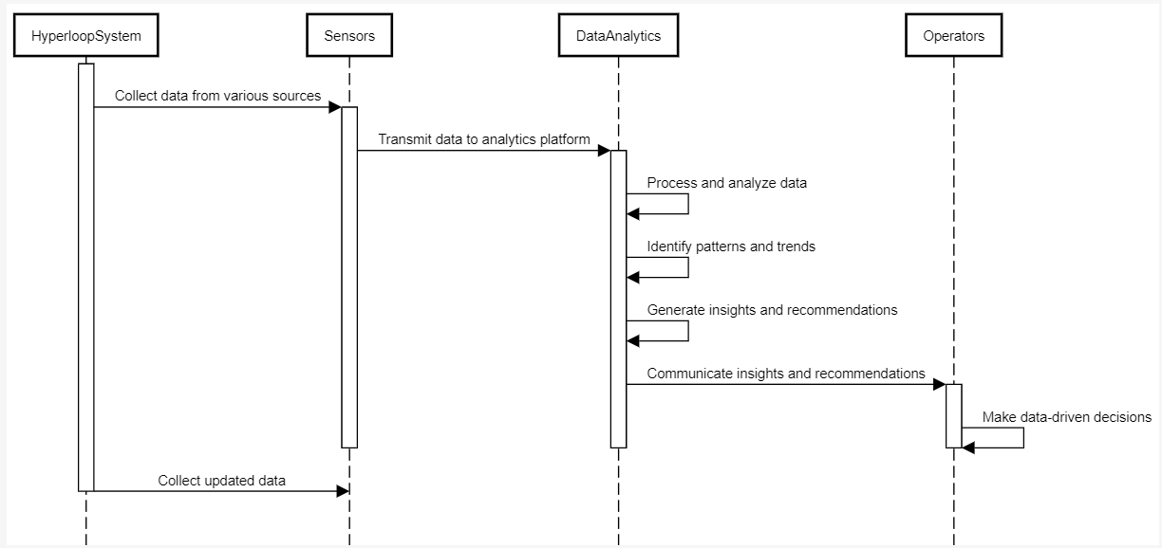
Data analytics:
Data analytics can play an important role in the Hyperloop system by providing insights into the performance of the system, identifying areas for improvement, and predicting potential issues before they occur.
Real-time data analytics in Hyperloop can help monitor and optimize the performance of the system. The data generated by various components such as sensors, actuators, and control systems can be analyzed in real-time system can be adjusted to maximize efficiency and reduce energy consumption. This can help improve the overall performance of the Hyperloop system and reduce operating costs.
Real-time data analytics can be achieved using various techniques such as machine learning algorithms, statistical analysis, and visualization tools. The data can be processed in real-time using specialized hardware and software solutions, allowing for fast and accurate analysis of the data.
(fig8-data analytics sequence diagram)

Slide 12
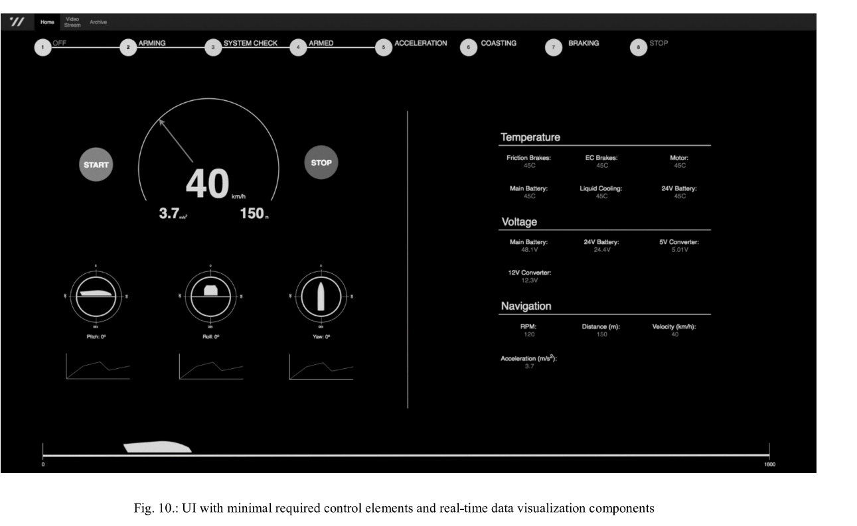
User Interface Layer:
The user interface layer would provide a way for humans to interact with the Hyperloop system. This layer would include various interfaces such as touchscreens, displays, or other types of user interfaces that allow operators to monitor the performance of the system and make adjustments as needed.
The user interface layer typically includes features such as system status displays, alarm notifications, and real-time data visualization tools that provide operators with a detailed view of the system's performance. The user interface layer can also include controls that allow operators to make adjustments to the system's operation, such as adjusting the speed or acceleration of the Hyperloop pods, or changing the operating parameters of the levitation or propulsion systems.

Slide 13
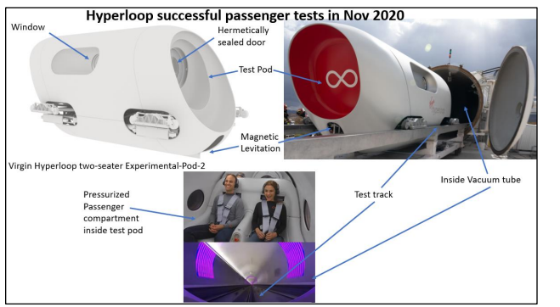
RECENT IMPLEMENTATION
The first passenger test of hyperloop technology was successfully conducted by Virgin Hyperloop with two employees of the company in November 2020 at test track in the desert outside Las Vegas, Nevada, where the unit reached a maximum speed of 172 km/h (107 mph).
(fig10- hyperloop technology was 1st successfully human trial)

Slide 14
MERITS
High speed: Hyperloop technology has the potential to reach speeds of up to 760 mph (1,200 km/h), which is much faster than traditional forms of transportation and therefore reduces travel time.
Energy efficient: Hyperloop technology is designed to be highly energy-efficient and eco-friendly, with the ability to generate and store its own energy using renewable sources like solar power.
Weather-independent: Hyperloop technology is not affected by weather conditions like snow or rain, as the pods travel through enclosed tubes.
Low maintenance costs: Due to its simple design and lack of moving parts, Hyperloop technology is expected to have low maintenance costs compared to other forms of transportation.

Slide 15
DEMERITS
High implementation costs: Building a Hyperloop system requires a significant amount of investment, which makes it expensive for many regions and governments.
Reduced comfort: Due to the high speeds and acceleration of Hyperloop pods, passengers may experience discomfort or motion sickness and dizziness during the ride.
Regulatory challenges: The development and operation of Hyperloop systems could face regulatory challenges and opposition from various stakeholders, including governments, transportation companies, and environmental groups.

Slide 16
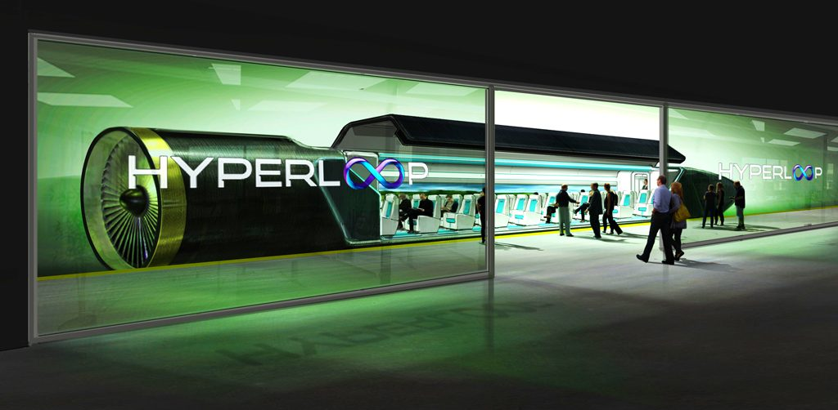
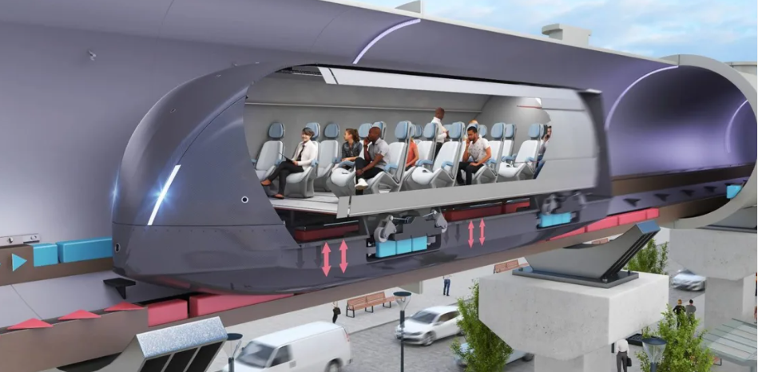
APPLICATIONS
Urban passenger transportation: Hyperloop systems could be used to connect different parts of a city or regions, reducing traffic congestion and making it easier for people to travel around the city.
(fig13- representation of urban transportation)

Slide 17
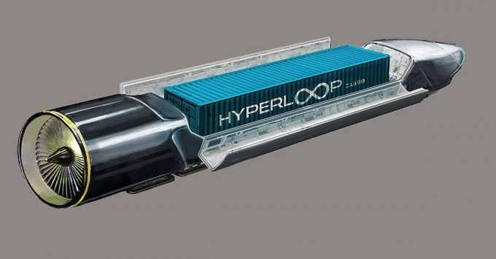
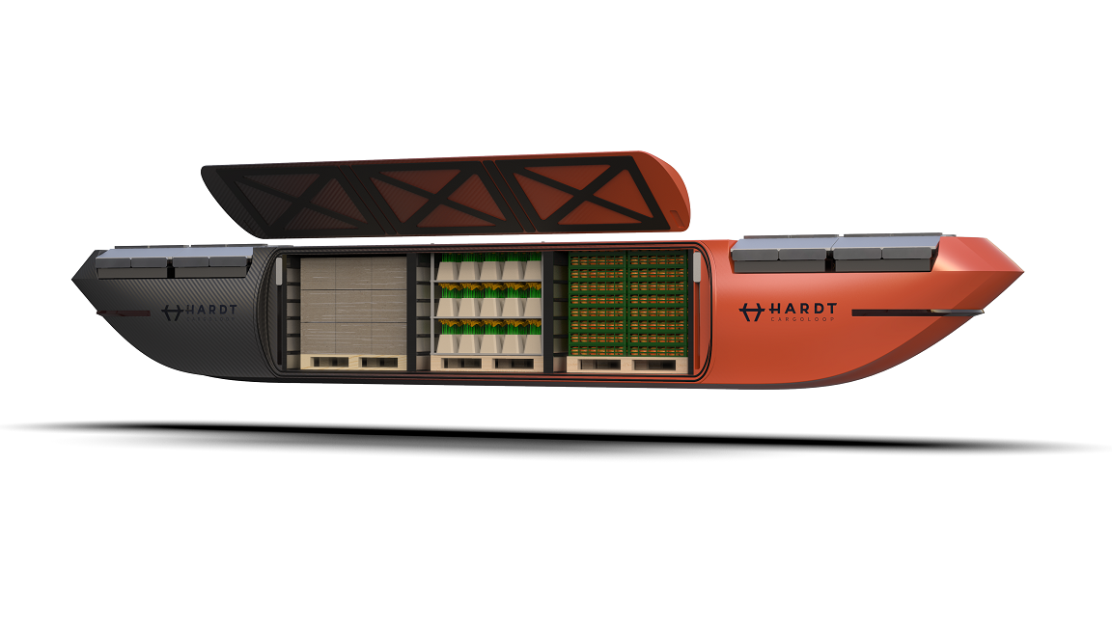
Cargo transportation: Hyperloop technology could also be used to transport cargo quickly and efficiently, which could have significant benefits for industries like logistics and e-commerce.
Emergency transportation: In emergency situations, such as natural disasters , medical or surgical emergencies and military emergencies Hyperloop technology could provide a faster and more efficient way to transport people and supplies.
(fig14- representation of cargo and emergency transportation)

Slide 18
CONCLUSION
In conclusion, the Hyperloop technology is a significant game changer in the transportation industry, providing a futuristic and sustainable mode of transportation.
Its successful implementation has the potential to bring significant benefits to society by creating new business opportunities and improving connectivity and helps to boost the economic development of the country.
With its high speeds, low emissions, and efficient use of energy, the Hyperloop system could offer a sustainable , cost-effective and eco-friendly alternative to traditional transportation options.

Slide 19
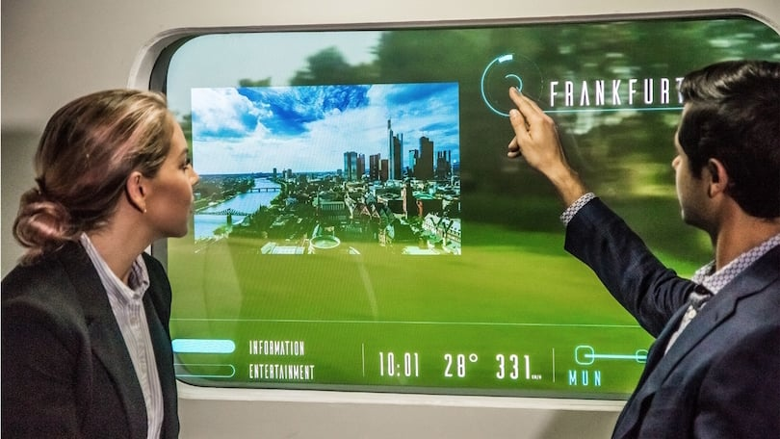
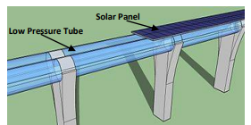
FUTURE ENHANCEMENTS
Augmented reality and entertainment: Hyperloop systems could be equipped with augmented reality systems that could provide passengers with entertainment, information, and even virtual reality experiences during their journey.
Improvements in comfort and passenger experience: Future enhancements could focus on improving the comfort and passenger experience in the Hyperloop pods. This could include innovations in seating, entertainment systems, and temperature control.
Integration with renewable energy sources: To further reduce emissions and increase sustainability, the Hyperloop could be integrated with renewable energy sources such as solar, wind, or hydroelectric power. This would make the system even more environmentally friendly and cost-effective.
(fig15- depection of using AR inside hyperloop)
(fig16- solar pannel mounted on top of tubes )

Slide 20
REFERENCES
[1] “Demand for Passenger Capsules for Hyperloop High-Speed Transportation System”- Case Study From Poland” - IEEE – Published on March 2022.
[2] “Towards sustainable transportation: The development of hyperloop technology in Saudi Arabia” –WJETR- Published on July 2022.
[3] “Hyperloop: The innovative logistic technology”- WJETR – Published on
March 2022
[4] “DESIGN AND ANALYSIS OF HYPERLOOP ” - IJERT– Published on April 2022
[5]” User Preferences towards Hyperloop Systems: Initial Insights from Germany”
-MDPI –Published on October 2022

Slide 21
[6] “Hyperloop Communications: Challenges, Advances, and Approaches” - IEEE – Published on October 2021
[7] “Analysis on technical aspect of a Hyperloop system” - IJERT– Published on November 2021
[8] “Hyperloop, The New Transport System”- IJERT – Published on
special issue 2021
[9] “Prospects and Challenges of the Hyperloop Transportation System: A Systematic Technology Review”- IEEE – Published on February 2021
[10] “Hyperloop Academic Research: A Systematic Review and a Taxonomy of Issues”- MDPI – Published on June 2021

Slide 22
THANK YOU

